Slide 1

Lemon Leaf Disease Detection Using CNN & MobileNet
Presented By
Mujibul Haque Tanim
ID: MC-243102
Course Teacher
Mahadi Hassan
Associate Professor,
Dept of Computer Science & Engineering, IIUC.

Slide 2
Introduction
Background: Agriculture is essential to global sustainability, but plant diseases threaten crop yields and quality.
Objective: Harnessing the power of deep learning to accurately detect and classify lemon leaf diseases.
Focus: The Lemon Leaf Disease Dataset (LLDD), analyzed using CNN and MobileNet based models.
Impact: Empowering farmers with AI-driven tools for disease prevention and sustainable farming practices.

Slide 3
Literature Review:
No | Name of the Papers | Authors | Publishers & Year | Methods & Dataset | Findings
01 | Lemon Leaf Disease Classification Using CNN-based Architectures with Transfer Learning | Md. Aktaruzzaman Pramanik, Md. Akib Zabed Khan, Al Amin Biswas. | Journal: IEE (conf) Year: 2021 | DenseNet-201, ResNet-50, ResNet-152V2, and Xception Dataset: Self-Made | Result: Highest Accuracy 94.34% accuracy achieved with Xception.
02 | Automated Lemon Quality Detection using DenseNet121: A Deep Learning Approach | Pratham Kaushik, Saniya Khurana | Journal: IEE (conf) Year: 2025 | DenseNet121 Dataset: Self Made. (not public) | Result: Highest Accuracy of 96% .
03 | Amalgamated convolutional long term network (CLTN) model for Lemon Citrus Canker Disease Multi-classification | Rishabh Sharma, Vinay Kukreja | Publisher: DASA (Conf) Year: 2022 | Hybrid of (CNN + LSTM) Dataset: Self-Made. (not public) | Result: the model achieves remarkable binary classification accuracy of 94.2% and early-stage multi-classification accuracy of 98.43%

Slide 4
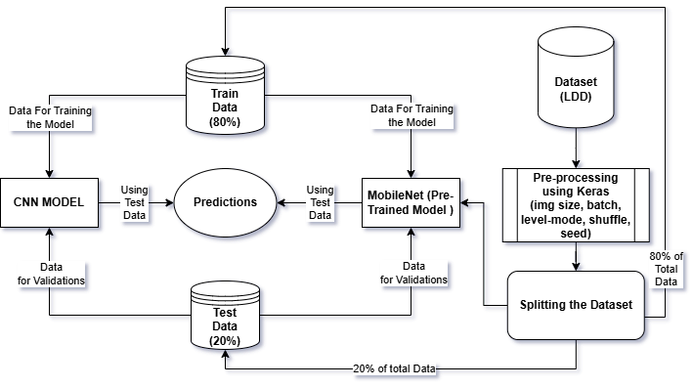
Proposed Methods:

Slide 5
Dataset:
Name: | Lemon Leaf Disease Dataset (LLDD)
Categories: | Healthy | Diseased
Images: | Total: 1354 | Format: JPG
Types | ['Bacterial Blight', 'Curl Virus', 'Healthy Leaf', 'Dry Leaf', 'Deficiency Leaf', 'Spider Mites', 'Anthracnose', 'Sooty Mould', 'Citrus Canker']
Source: | Kaggle

Slide 6


Tools & Techniques
Tools
Libraries
Numpy
Panda
Sklearn
Keras
Matplotlib, sns

Slide 7
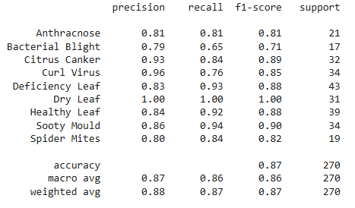
Classfication Report of CNN-Based Model

Slide 8
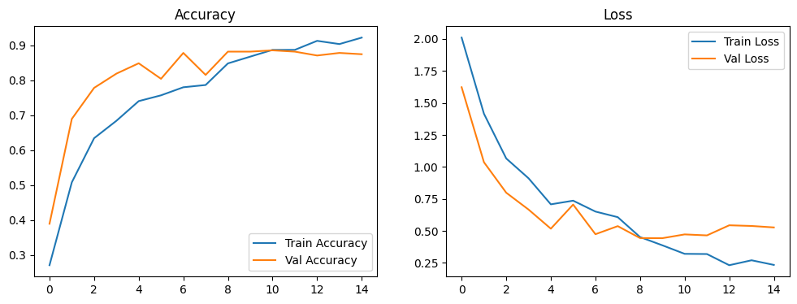
Accuracy Vs Loss Graph (CNN-Based Model)

Slide 9
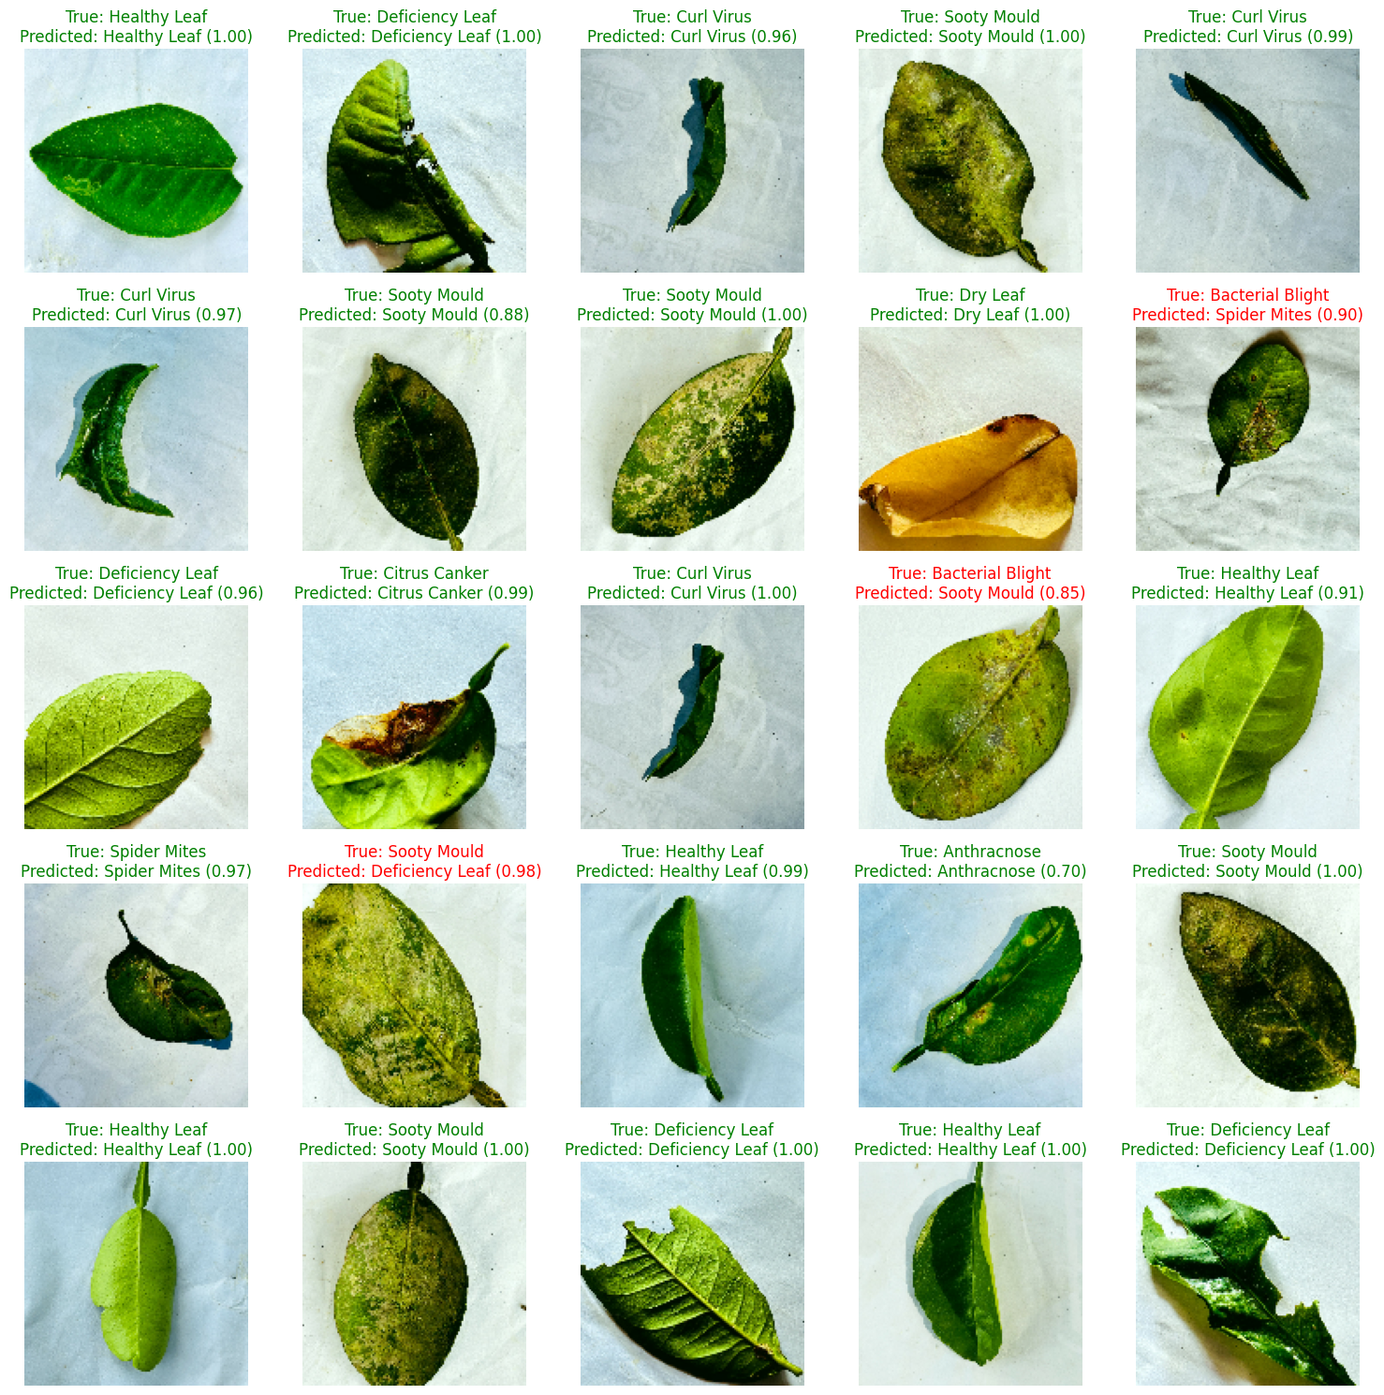
Predictions of CNN-Based Model

Slide 10
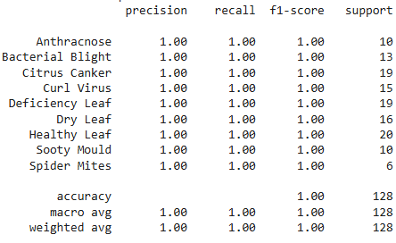
Classification Report of MobileNet (Transfer Leaning)

Slide 11
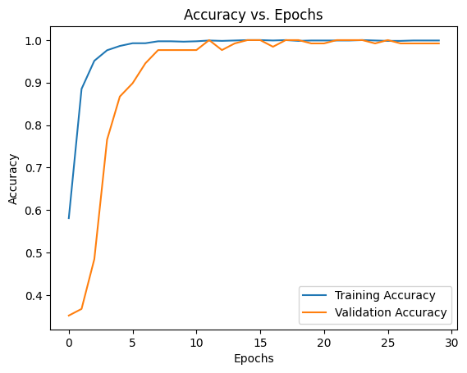
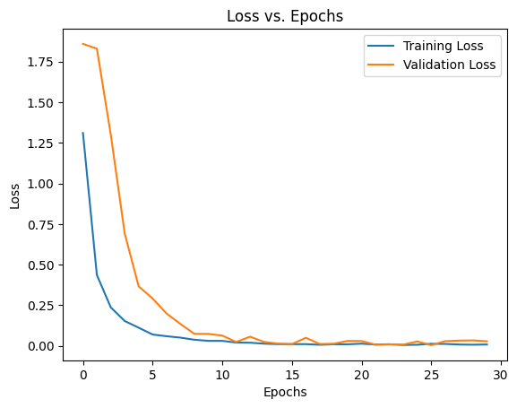
Accuracy Vs Loss Graph of MobileNet (Transfer Leaning)

Slide 12
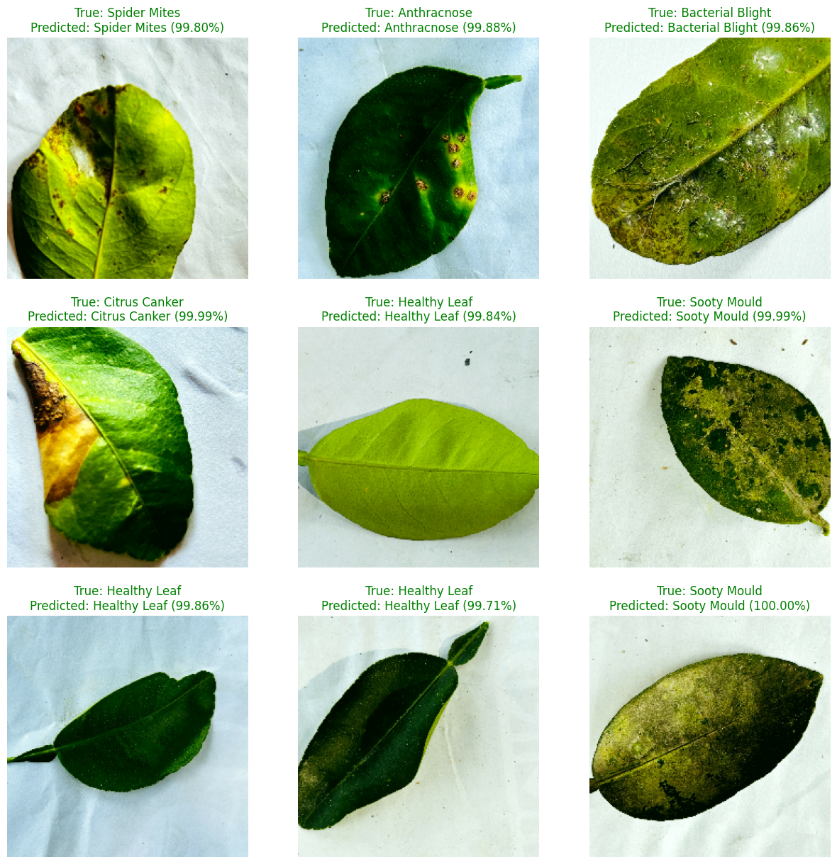
Predictions of MobileNet (Transfer Leaning)

Slide 13
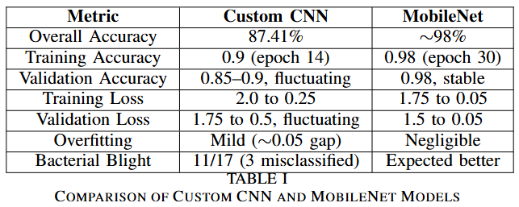
Comparative Analysis:
This section presents a direct comparison of the performance metrics achieved by our Custom Convolutional Neural Network (CNN) and the MobileNet architecture on the image classification task. The following table summarizes key results, highlighting the strengths and weaknesses of each model across various evaluation criteria.

Slide 14
Conclusion & Future Work:
Conclusion:
MobileNet is the superior model for this task, offering a substantial improvement in accuracy.
Further investigation into the CNN's architecture or training process could improve its performance, but MobileNet provides a strong baseline.
The efficiency of MobileNet also makes it a potentially better choice for deployment in real-world applications.
Future Work:
Try different CNN architectures or MobileNet versions.
Explore advanced techniques like transfer learning or ensembling.
Increase the dataset diversity.

Slide 15
Thank You

